Slide 1



SkyInsights - A Weather Prediction Project

Slide 2

Introduction
The purpose of the project is to provide accurate weather prediction based on probability. Our website allows users to input their location and receive the temperature and the probability of rain in that area.

Slide 3

Working
Collection of Data
We collect current temperature and rain information using APIs to ensure up-to-date data.
Calculation of Probability
Our algorithm considers temperature, recent rain, and time to calculate the probability of rain in a specific location.
Display of Results
Users receive the temperature and the rain probability for their input location on our website.

Slide 4
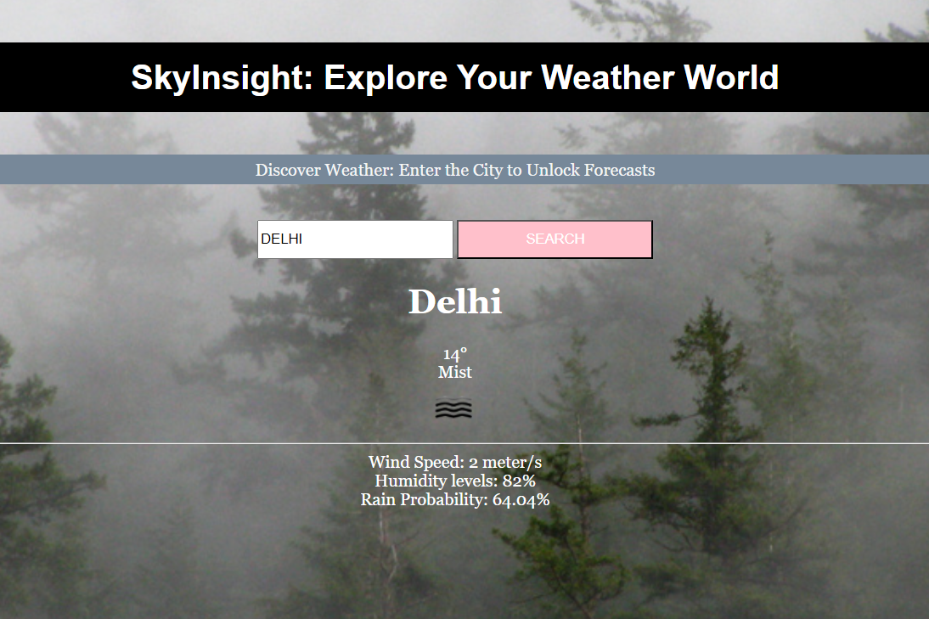
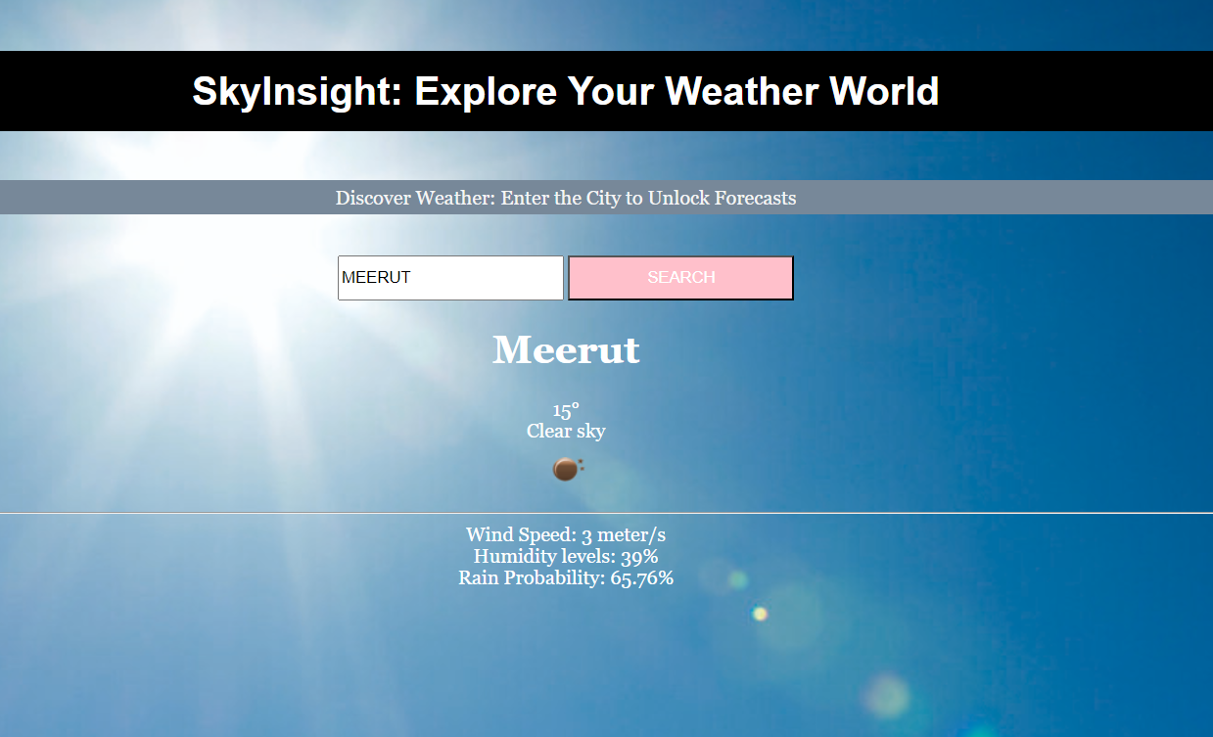
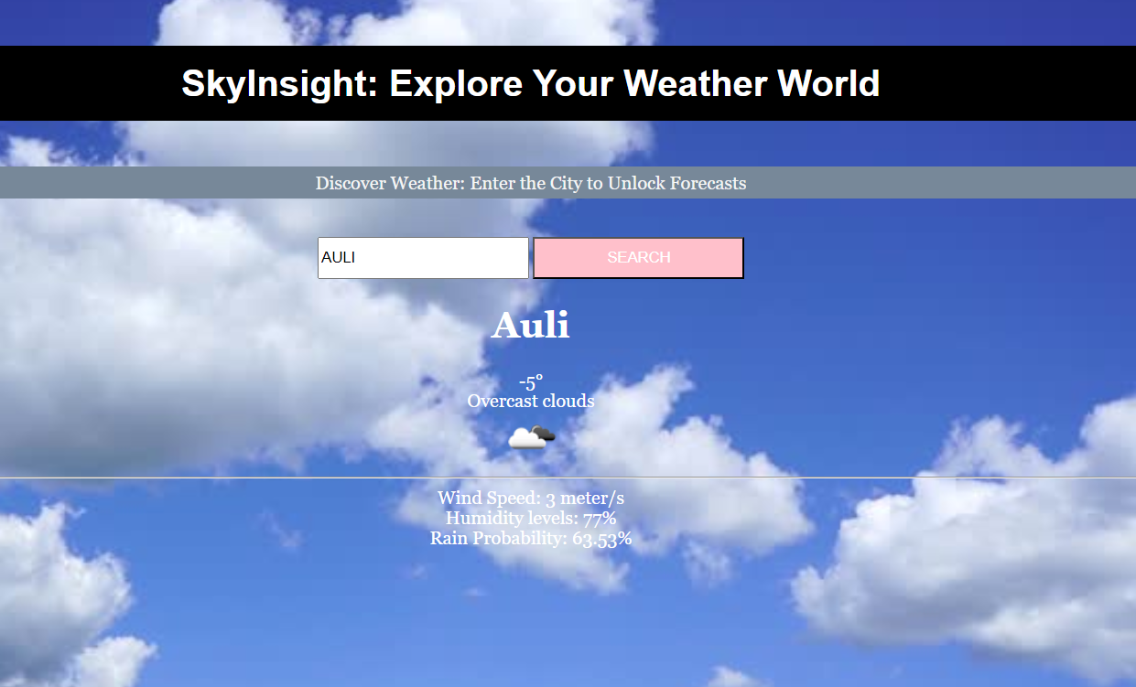
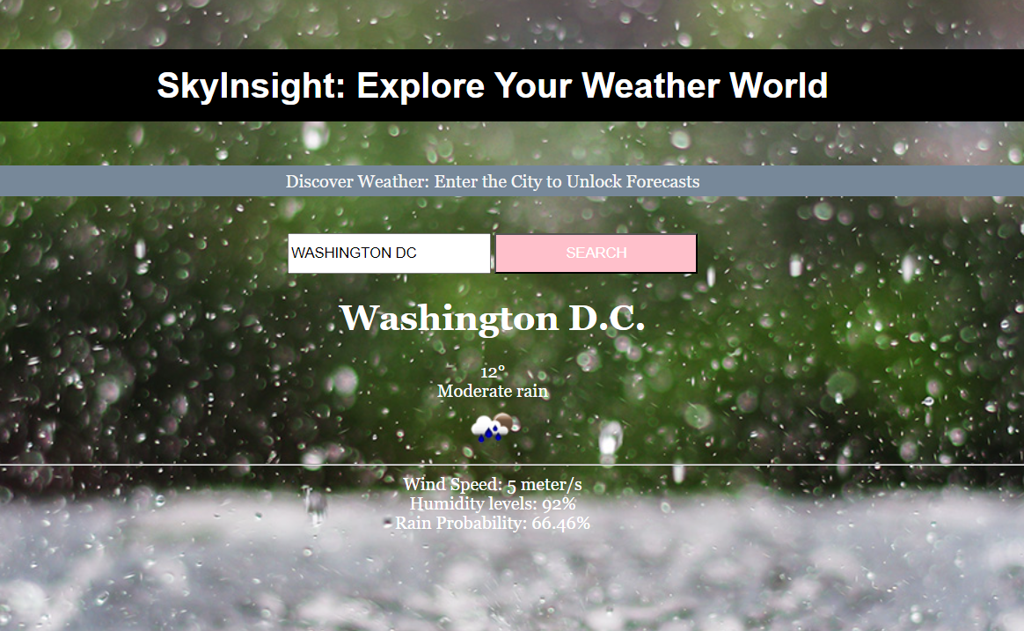

Slide 5

Conclusion
Benefits of SkyInsights
SkyInsights provides accurate weather predictions, especially useful for planning outdoor activities.
Future Development
We plan to integrate additional factors and improve the accuracy of our predictions.
Call to Action
Try SkyInsights now for reliable weather forecasts and never be caught unprepared!

